Slide 1

ACM ICPC Practice Session
Bat - batsa003@umn.edu

Slide 2
What is ACM-ICPC?
“Olympics of Programming Competitions”
Regional competitions are all around the world
Participants come from 2000 universities, 80 countries
Teams of 3
First round: ACM ICPC Regionals
For us ACM North Central North America (NCNA)
Second round: ACM ICPC World Finals
School pays for everything.

Slide 3

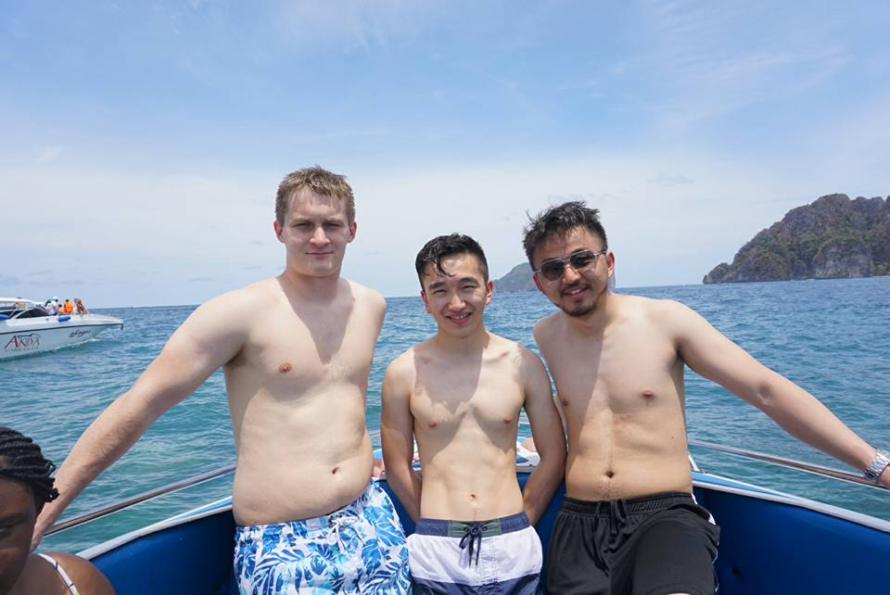

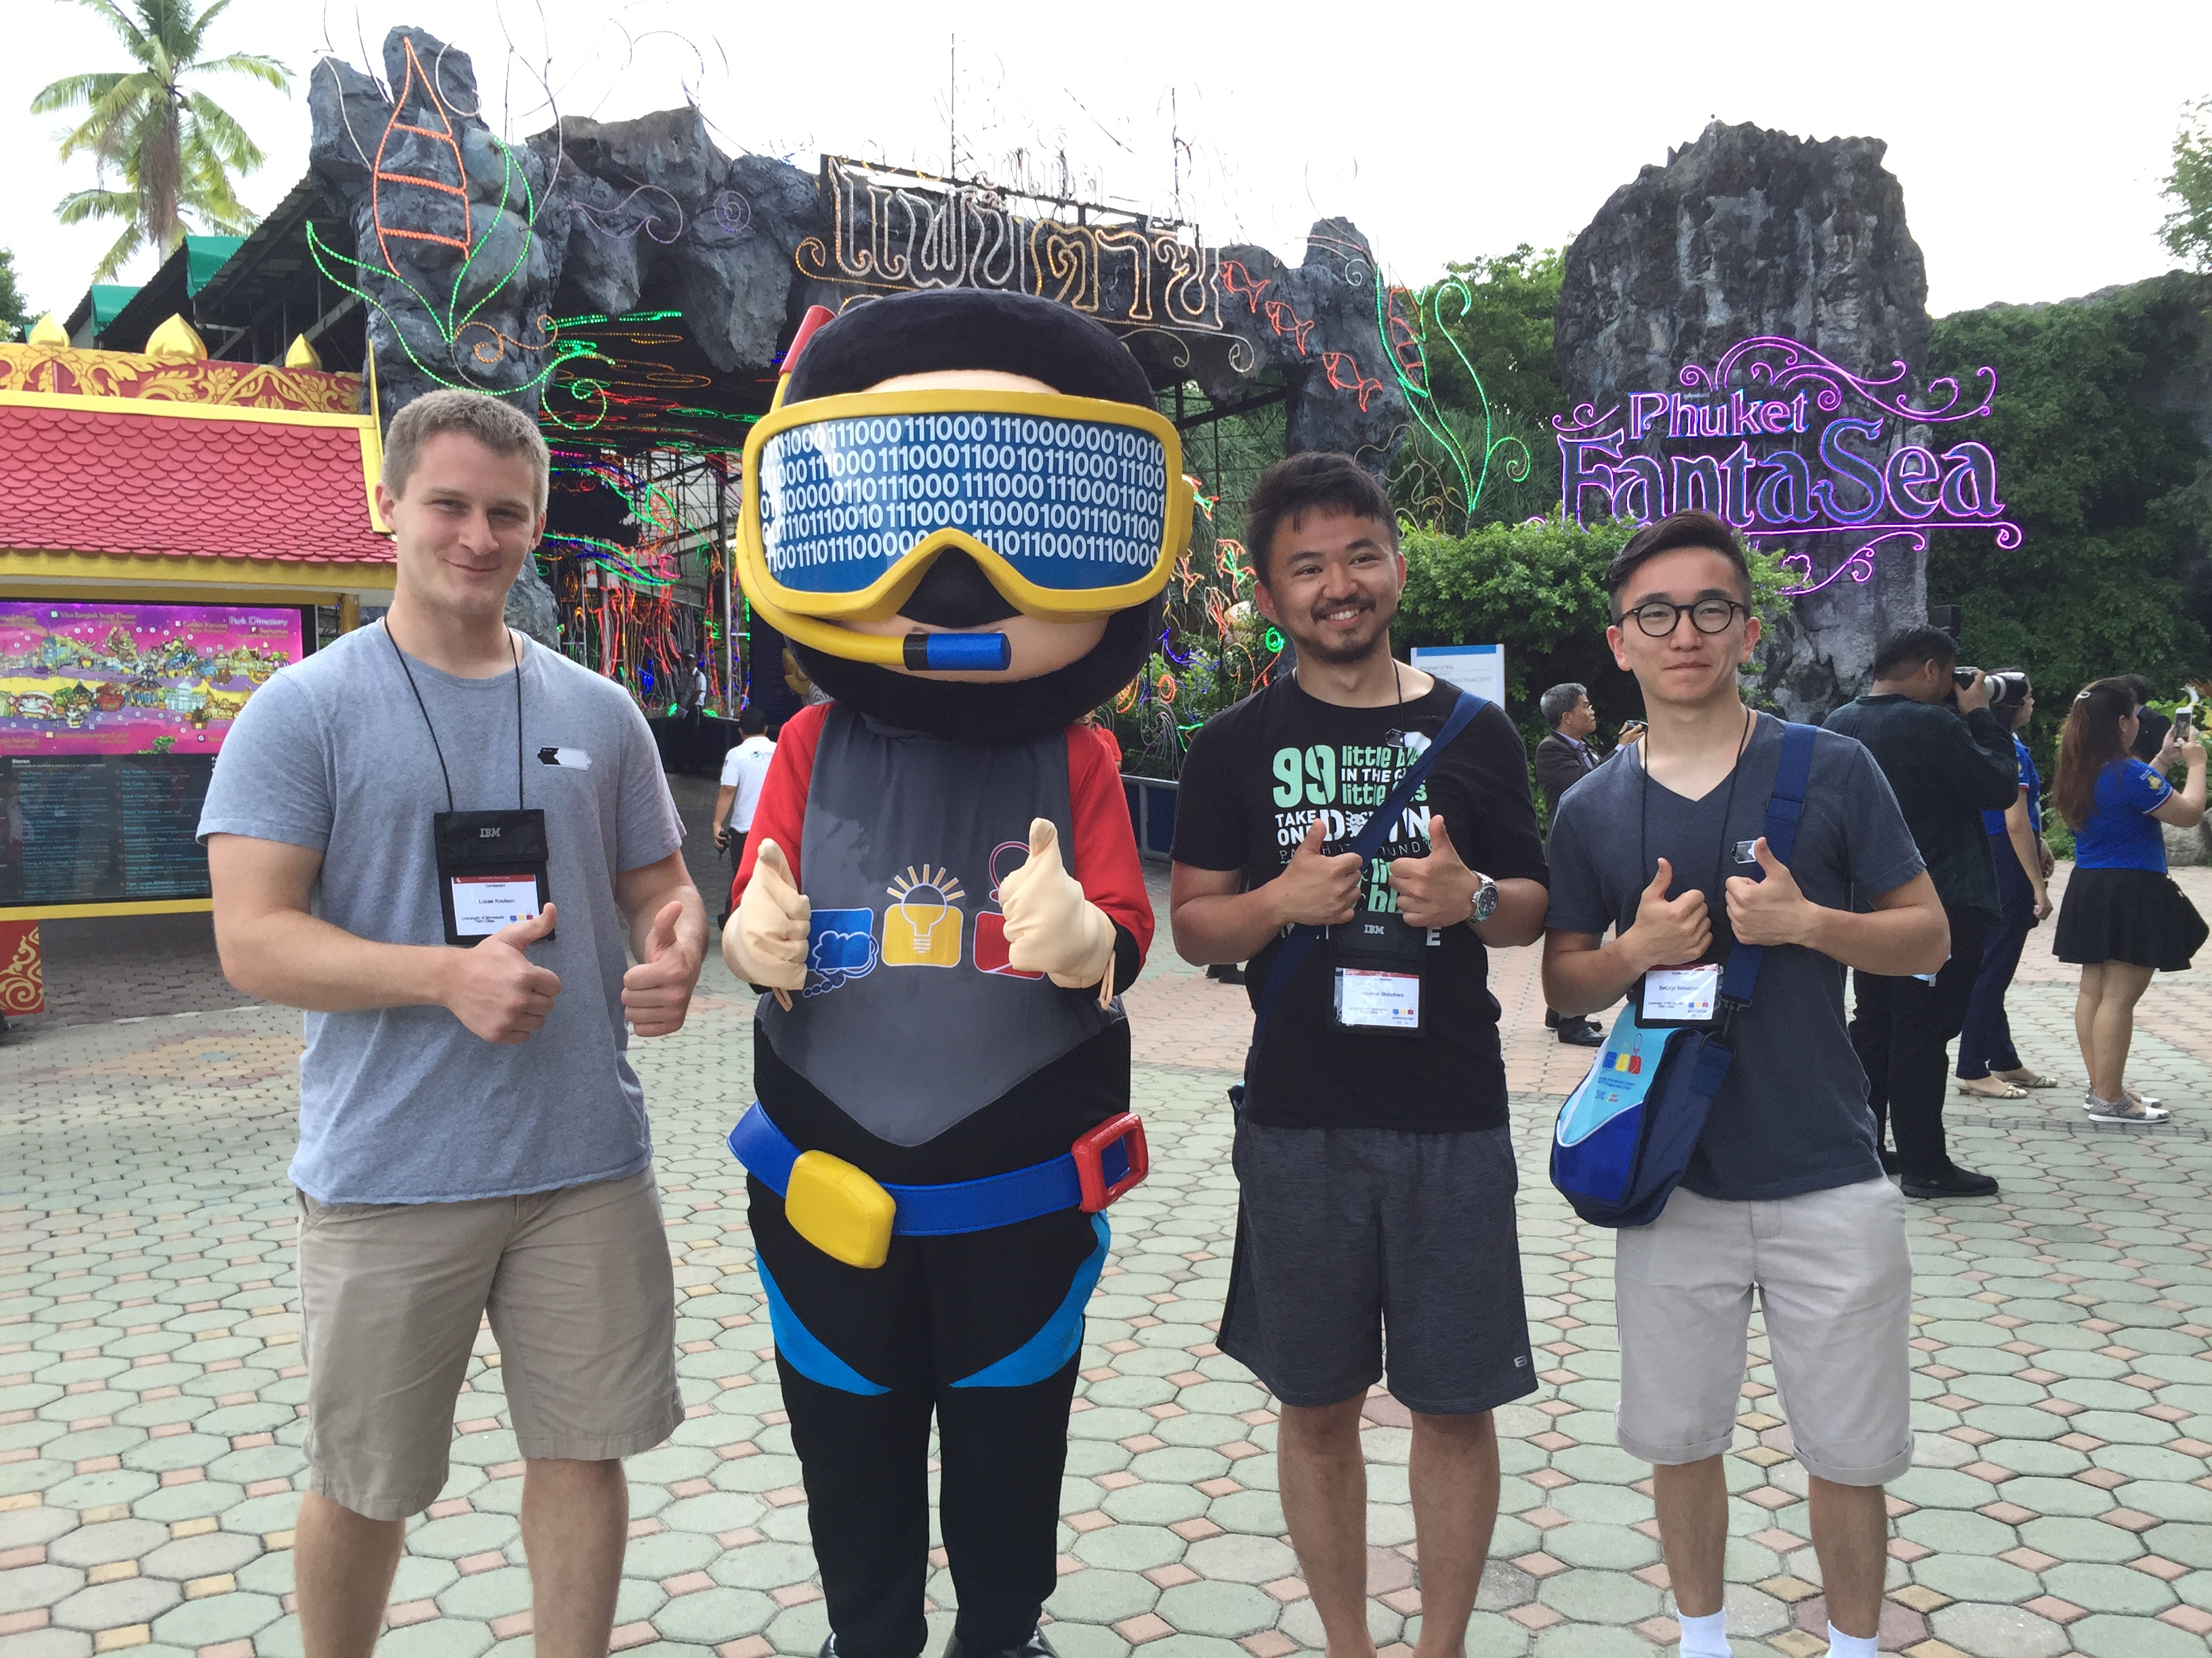
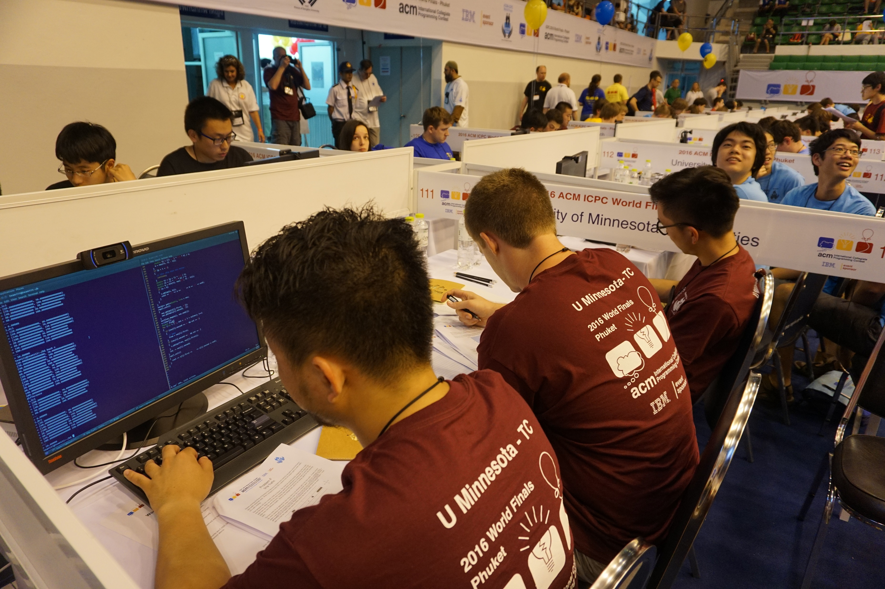
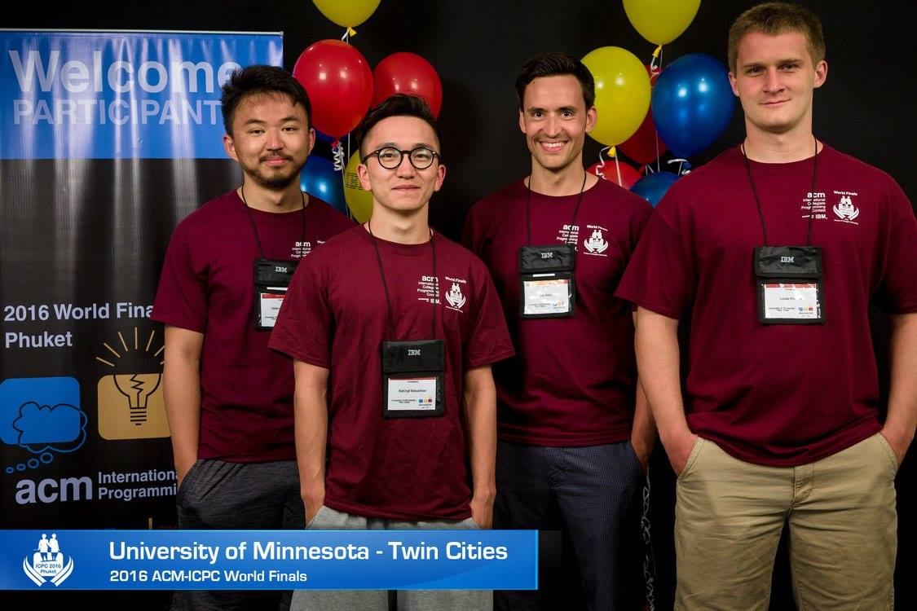
World Finals in 2016

Slide 4
ACM ICPC Regionals North Central North America
About 200 teams from Midwest
Top 3-4 teams qualify for World Finals
When: Saturday, October 28th, 2017
Where: Need to drive off-site (maybe Wisconsin)
Registration and info: cs.umn.edu/icpc, email
Register early, late fee if later than October 15th

Slide 5
Benefits of ACM-ICPC
Problem solving + Coding skills
Helps you in classes
Makes you a better thinker
Very helpful for technical interviews
Google, Facebook, Microsoft, etc,.
FUN
Competitive Programming community

Slide 6
Contest Format
8-10 problems in 5 hours
C++, Java, and (Python)
For each problem, read the input from STDIN and output to STDOUT
Your solution is tested on a system test ( ~ Many testcase)
If you pass all tests, you get the score.
If your solution is too slow or gives an error, you don’t get it.
Environment:
Ubuntu, terminal
Eclipse or IntelliJ? for Java
Clion or Code::Blocks for C++

Slide 7
Scoring
Rank by number of problems solved, if there is a tie, use penalty time
Penalty time = Sum of total time for each problem + 20 * Number Of Unsuccessful Attempt
World Final 2016 Scoreboard

Slide 8
Practice Session format
Problem set every week
For the next 2 weeks, I will give you reading, and the problem set will be related to the readings.
The rest of the practice is just practice contests
I’m here to help you on anything
Coding issues
Practicing
Discussing problems & solutions

Slide 9
Resources
Coding competitions:
Codeforces.com
Codechef.com
Hackerrank.com
Topcoder.com
http://web.stanford.edu/class/cs97si/
First 7 chapters are enough.
Regional competitions in codeforces.com/gyms

Slide 10
Resources
General techniques to solve problems: http://codeforces.com/blog/entry/20548
At regional level, LEARN these:
Dynamic Programming, Greedy, Basic Graph Algorithms (dfs, bfs, dijkstra), Math (fast exponentiation, binomials, etc,.), Binary Search
Practice a lot of regional level problems
(Codeforces Div 2 – A,B,C)
(Topcoder Div 2- A,B,C)
Do similar practice contests, if possible
Regular practice as a team

Slide 11
Problems
Start with this:
https://www.hackerrank.com/challenges/simple-array-sum
Might need an account in hackerrank
https://open.kattis.com/problems/babelfish
Open an account in kattis.
Google “GCJ tidy numbers”, first link.

